Slide 1
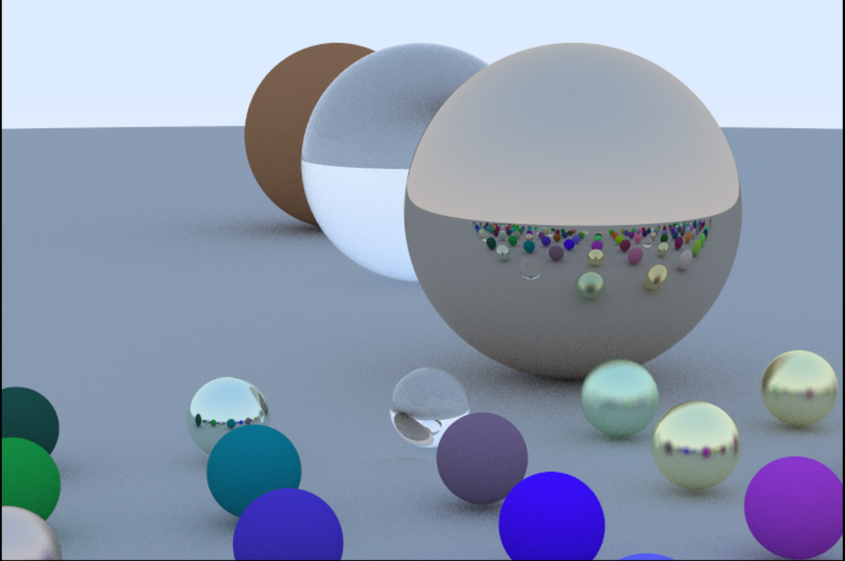
Raytracing in Haskell

Slide 2
Outline
Design overview
Introduction to raytracing and Physically Based Rendering (PBR)
Implementation details
Profiling and optimization
Q&A Section

Slide 3
Design considerations
Fast random numbers
Laziness
Low level or high level?
Which parts of the code will be the ‘hottest’?
Take advantage of parallelism?
Decided against low level or unsafe libraries– not Haskell enough. Use linear instead of vector

Slide 4
Dependencies
linear – a linear algebra library treating vectors as functors
mwc-random – extends random with a fast PRNG stateful, monadic interface
random – dependency of mwc-random
deepseq – force entire expressions to evaluate useful for eliminating memory leaks
AC-PPM – write color data to ppm output could be replaced with glossy for jpgeq or png
parallel – allow for parallel evaluation rendering is “embarrassingly parallel”

Slide 5
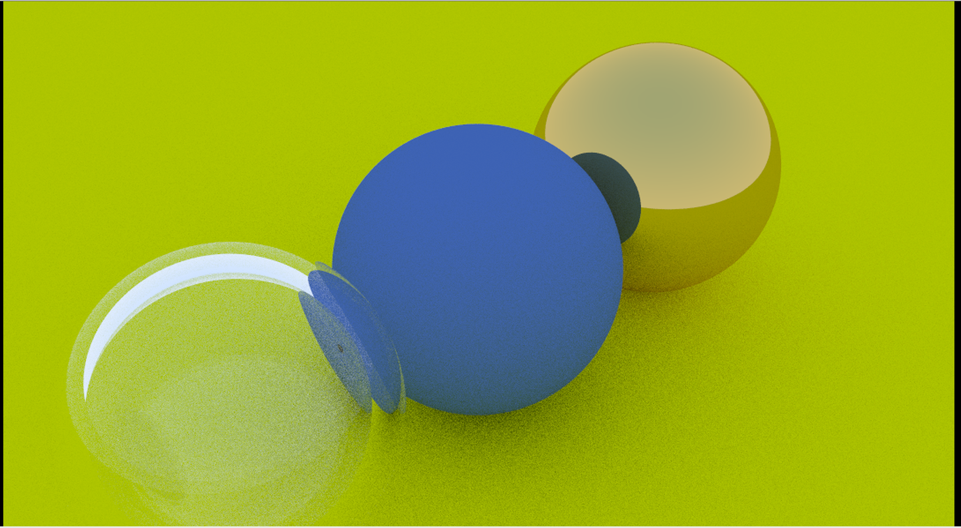
Global Illumination and Caustics
Direct hit from the sky is a light blue
Shadows are dark because it’s unlikely rays will reflect into them
Tinted green by light from the ground
Matte surfaces reflect toward a random unit vector
Reflective surfaces apply Snell’s law Dielectrics account for refraction through different mediums
Final color is mostly blue with a tinge of green from bounced light
Illuminated by refracted light

Slide 6
What are the rays for?
* Ray color is the weighted average of previous bounces
* As light bounces between participating media, the wavelength of refracted rays changes
* First bounce from light source has the least impact on the result
* Last bounce before camera lens has the most impact
* Rays traced in reverse, start with most impactful bounce. Random sampling is important.
* To reduce variance, average multiple paths
colorAt x (n+1) = reflectivity * weightedAverage(colorAt x n)

Slide 7
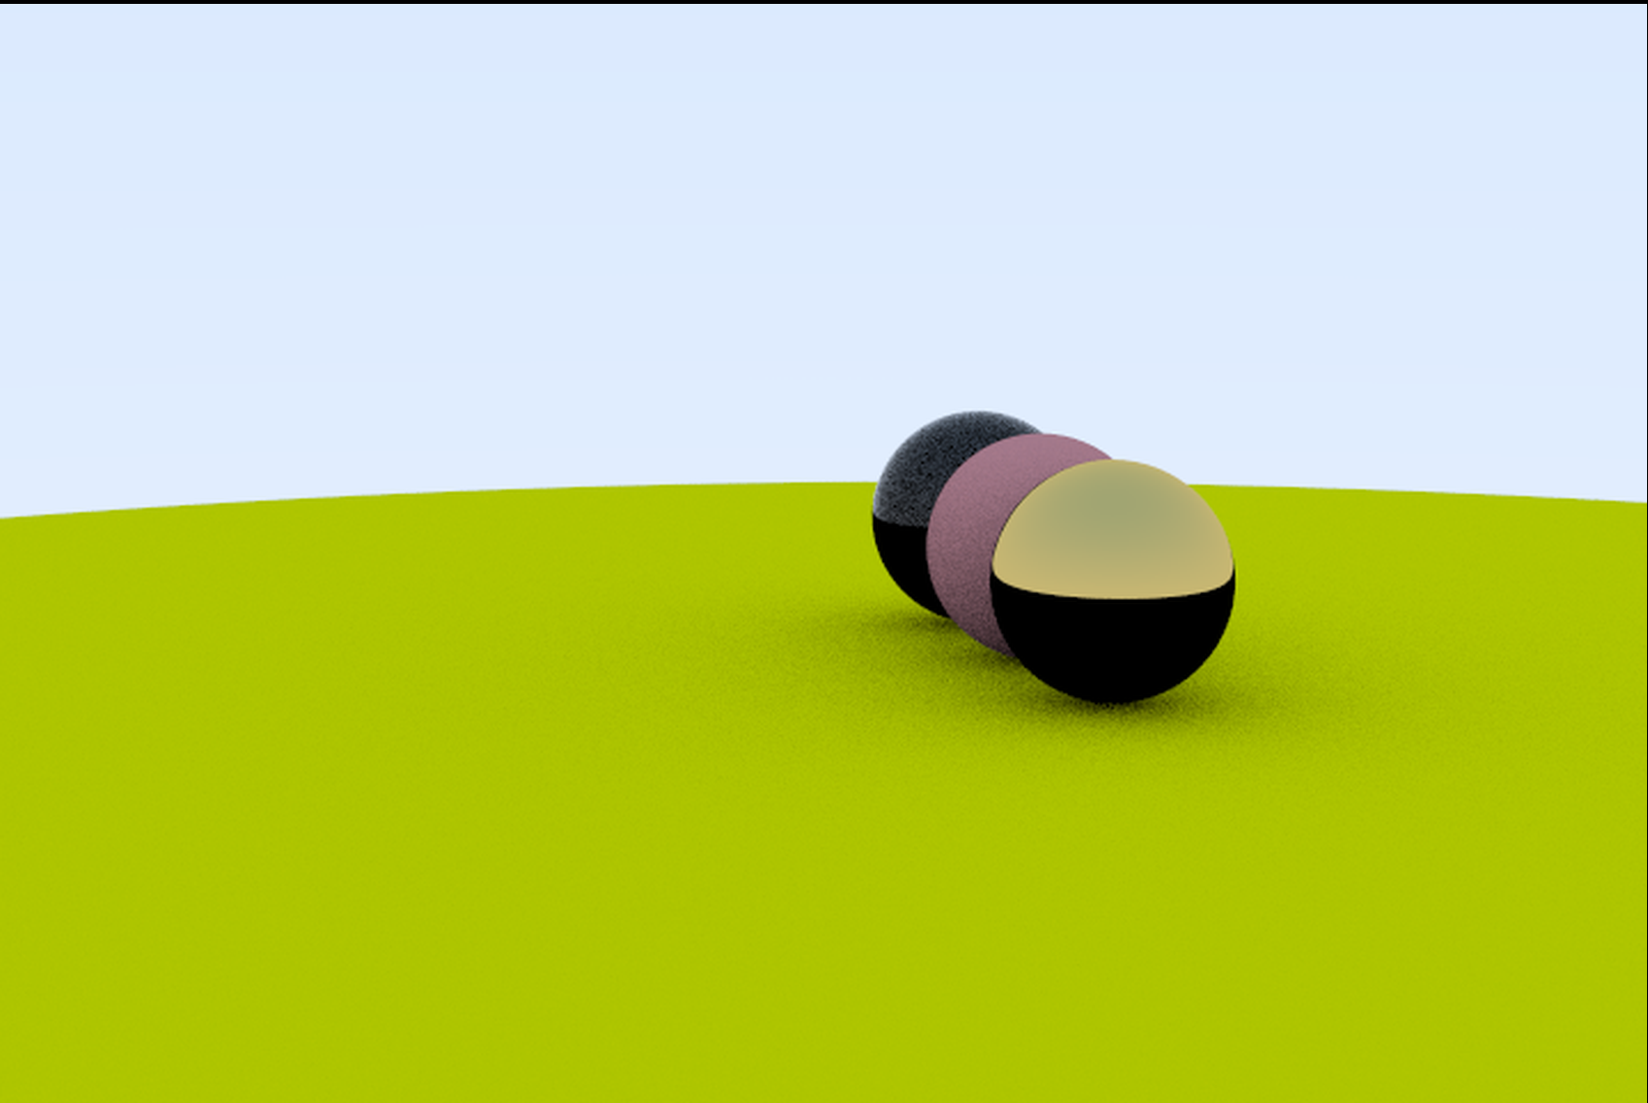
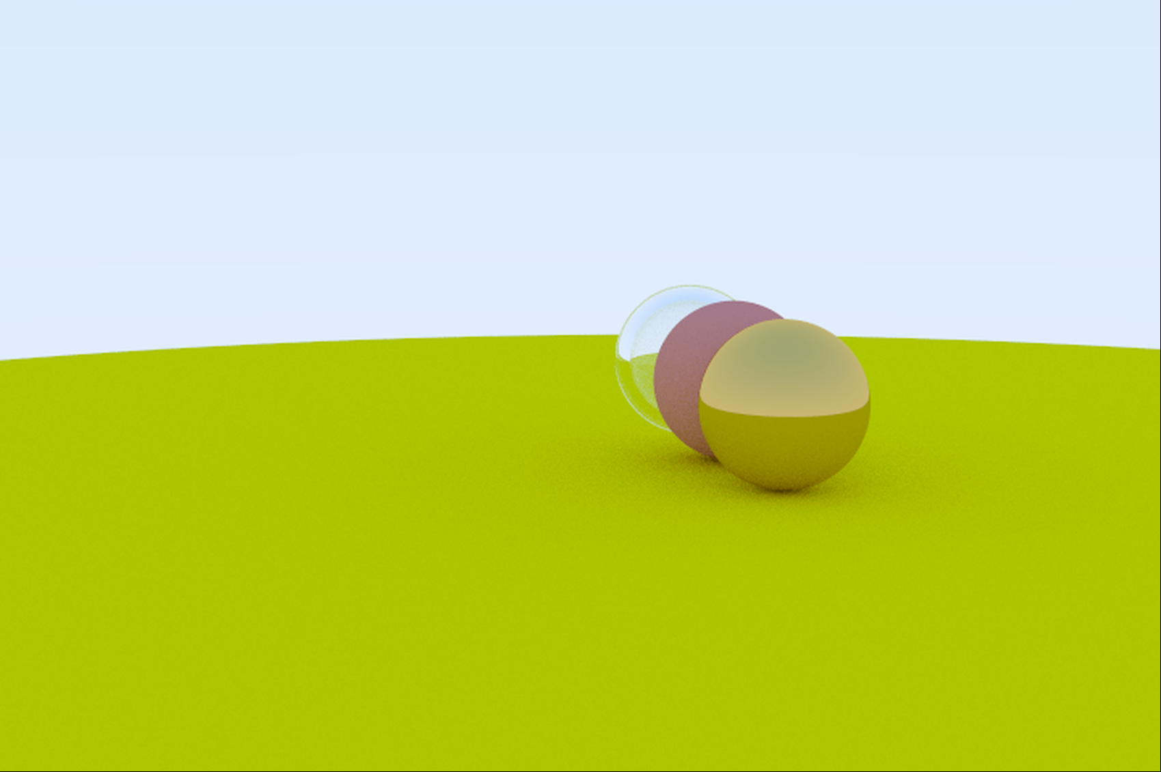


Fewer bounces means less refraction
Reflective surface behaves like matte
Refracted light eliminates shadows as bounces increase
100 samples, 2 bounces
100 samples, 50 bounces

Slide 8
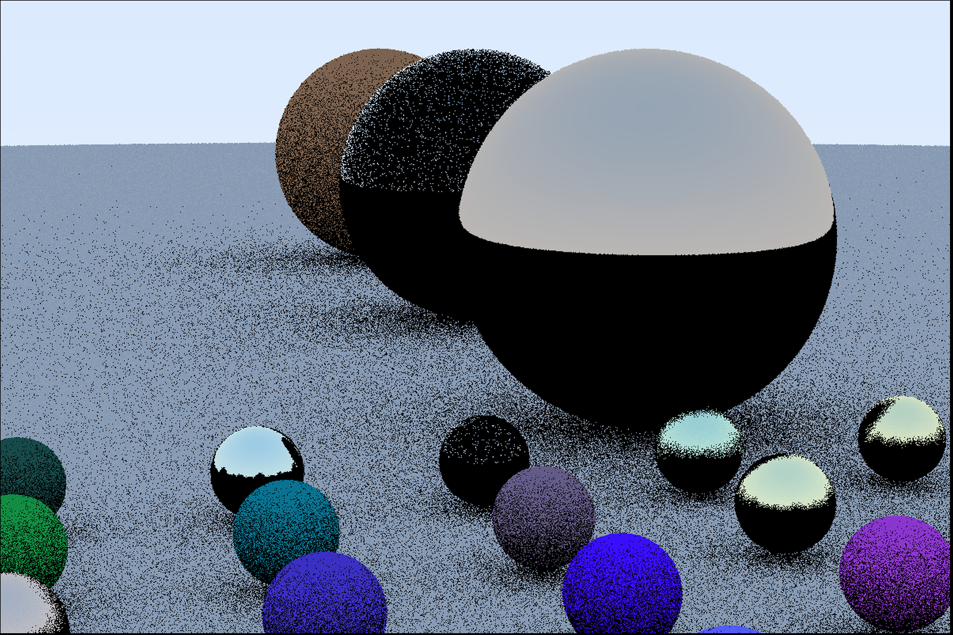

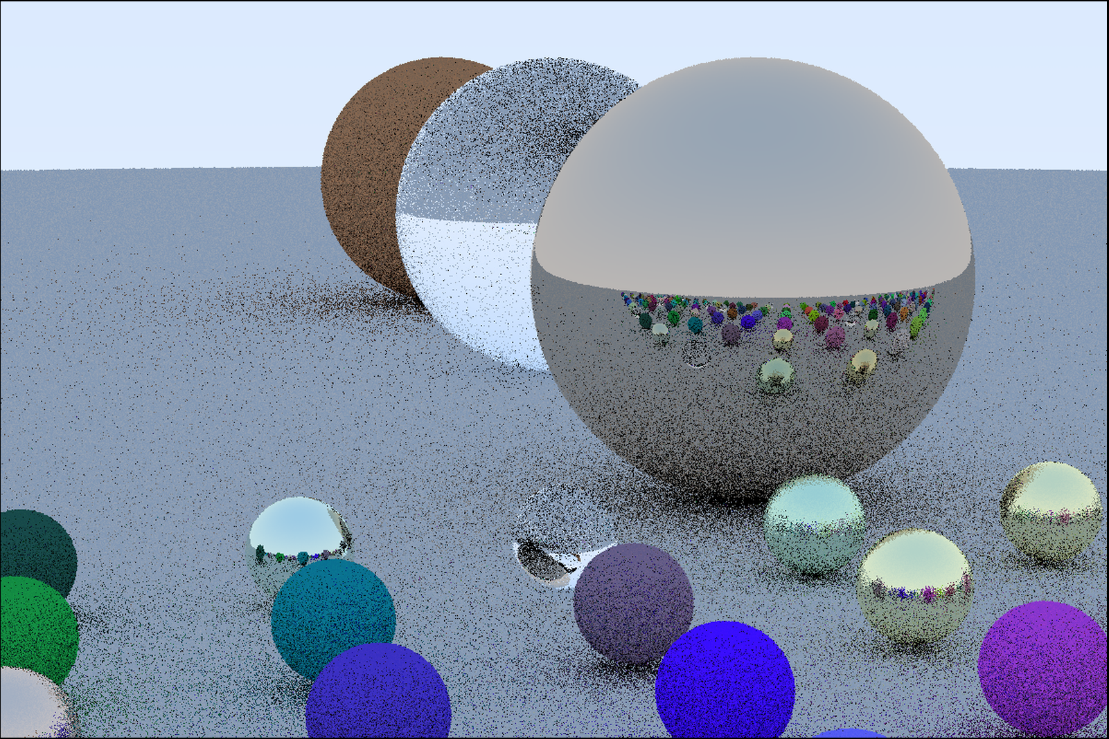
Soft shadows converge as sample count goes up
First bounce, one sample
5 bounces, 100 samples
Reflective surfaces need more bounces
Five bounces, one sample
50 bounces, 100 samples

Slide 9
Jargon explained
Quadrance is norm squared
quadrance a = ||a||^2 Avoids sqrt operation when comparing length directly to another number
Signorm normalizes vector without checking if it’s zero
signorm vec = vec ^/ norm vec
For raytracer, it is easy to make sure vectors are nonzero, saving lots of computation

Slide 10
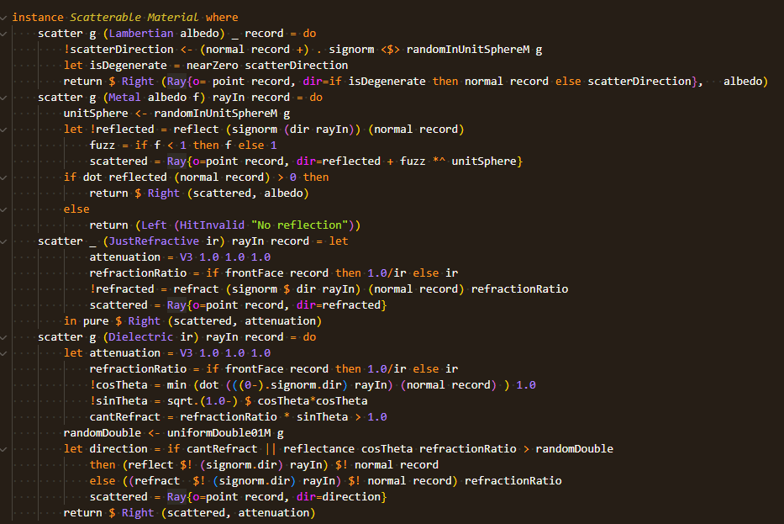
The implementation of ‘Scatterable’ decides material properties
Lambertian, Metal, and Dielectrics approximate physical materials
JustRefractive is a prototype for Dielectric materials
Heavily monadic to support fast random numbers
Refraction is deterministic
Describes light ray moving between different mediums

Slide 11
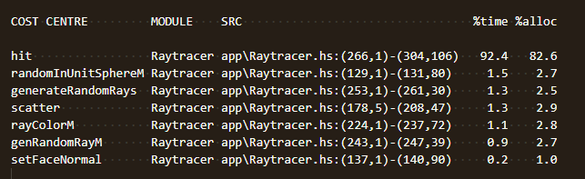
signorm vs. normalize
signorm normalizes vector without checking that norm is nonzero
normalize is safer, but if you can get away with signorm…
By ensuring random vectors are far from zero, checks can be removed from hot sections of the program

Slide 12
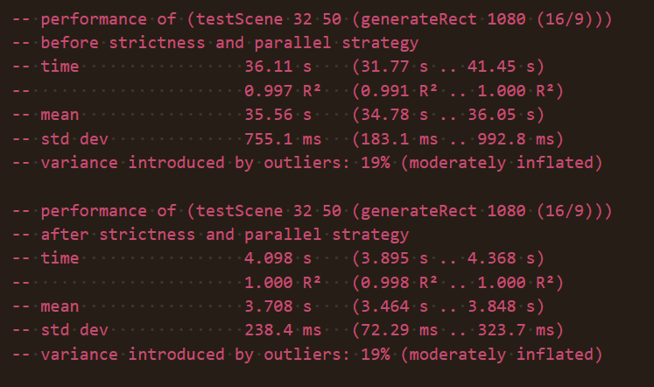
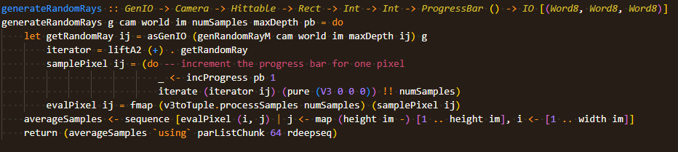
Optimizations
Use rejection sampling to filter degenerate rays
Force deep evaluation of light propagation code
Result will always be used
Small change to program speed, but 100x less memory
(IMPORTANT!!) Parallel strategies for 9x speedup

Slide 13
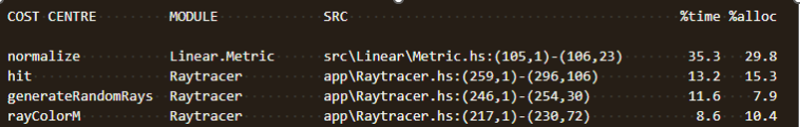
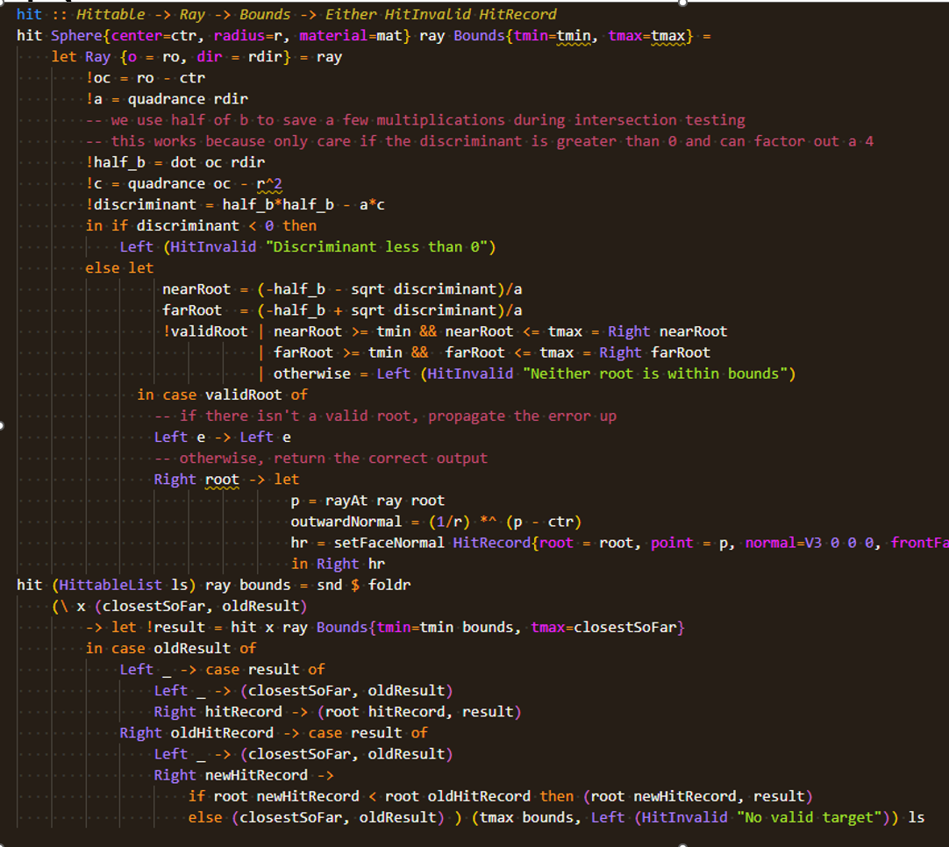
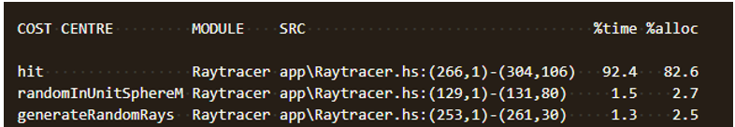
Cost Centers
Before replacing normalize with signorm
Case Study
Profiling necessary to make nontrivial output Where is laziness useful vs. useless?
If you know result will be used, why not evaluate now?
nearRoot always used, farRoot is not
Almost all time should be spent
calculating ray intersections Small improvements to hit make large impacts on execution time, especially for high detail images
After replacing normalize with signorm

Slide 14
Question and Answer

